Slide 1
Long-read sequencing technology
Jihe Liu
2020-05-15

Slide 2
Outline
Introduction
Frequently Used NGS Platforms
Nanopore sequencing
Applications
Extrachromosomal DNA identification
Structural variation
Other
Analysis tools

Slide 3
I. Frequently Used NGS Platforms
*
*
*: 5% – 15%
Notes:
Instrument Cost: NanoPore winner
Read Length
Error rate: key problems for interpreting result

Slide 4
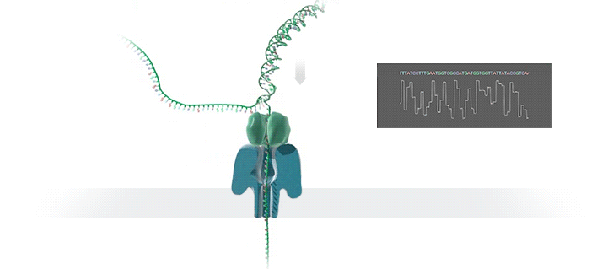
Oxford Nanopore Technology
Real-time base calling and analysis
Inexpensive (compared to PacBio) and portable
Long read length
High error rate (5% - 15%)

Slide 5
An Example of Nanopore Run
 | Glioblastoma Cell Line
Total runs | 3
Total reads | 11,098,662
Mean read length | 2982
Median read length | 1916
N50 | 4768
Coverage | 10 x
Mapped reads | 9422236 (84.90%)
Key amplified genes | CDK4, EGFR, MYC

Slide 6
II. Applications of Long-range Sequencing
Sedlazeck F, et al. Nat. Rev. Genet. 2018
Notes:
PacBio and Nanopore similar in application and bioinformatics challenges;
There are other short-read base, but provide info for long-range;

Slide 7
Application One: Identification of Circular Extrachromosomal DNA
Extrachromosomal DNA (normally containing oncogenes) frequently observed in cancer cells
Computationally challenging to identify full sequence through short-read sequencing

Slide 8
Assembly of Circular Extrachromosomal DNA Sequence
Align fastq reads against each other (minimap2)
9 − 14,211 (MT)
14,326 − 16,562 (MT)
Reconstruction of 16 kb circular mitochondria
1st raw assembly (miniasm)
1,153 kb
Align fastq reads to raw assembly (minimap2)
Curate the assembly (racon)
Chr21: 9,411,196 − 9,565,145
Chr2: 97,904,946 − 97,917,119
Chr7: 53,202,375 − 53,228,317
Chr17: 25,263,923 − 25,303,550
Chr16: 33,529,247 − 33,755,025
Chr21: 11,020,084 − 11,188,124
Align circular contig to human genome (minimap2)

Slide 9
Application Two: Detection of Different Structural Variation (SV)
Notes:
Not only common SV, but nested SV

Slide 10
Systematic Error in Short-read-based Structural Variation Calling
Use NA12878 human genome, but introduce 700 homozygous SVs at random locations
Sniffles detected far more indels than short-read-based caller
Short-read caller detected 27-fold more translocation events
Many were false, caused by mismapped reads across insertions
Sedlazeck F, et al. Nat. Methods, 2018
Notes:
Sniffles detected far more indels than short-read-based caller
Short-read caller detected 27-fold more translocation events

Slide 11
Detection of Nested SVs
Examples: INVDUP, INVDEL
INVDEL
INVDUP
Sedlazeck F, et al. Nat. Methods, 2018

Slide 12
Calling SV from long-read data
 | Long-read Data for Glioblastoma Cell Line
 | Sniffles | SVIM | Sniffles/SVIM Overlap based on breakpoint distance
Criteria | min_support = 4 | Score > 40 | 100 bp | 200 bp | 500 bp | 1000 bp
DEL | 7557 | 5339 | 2818 | 2863 | 2900 | 2906
INS | 4537 | 3590 | 2457 | 2464 | 2465 | 2463
DUP | 808 | 3821 | 12 | 37 | 226 | 379
INV | 146 | 883 | 17 | 23 | 26 | 32
TRA | 192 | NA | NA | NA | NA | NA

Slide 13
Calling SV from short-read data
 | Short-read Data for Glioblastoma Cell Line
 | Speedseq | Delly | Speedseq/Delly verlap
Criteria |  | Filter low quality, and imprecise calls | 100 bp | 200 bp | 500 bp | 1000 bp
DEL | 2256 | 4410 | 1545 | 1550 | 1553 | 1557
INS | NA | 1193 | NA | NA | NA | NA
DUP | 391 | 157 | 78 | 82 | 83 | 83
INV | 31 | 192 | 131 | 134 | 134 | 134
TRA | 2405 | 79 | 53 | 55 | 56 | 56

Slide 14
Consensus SV calls from both long- and short-reads
 | SVIM/Sniffles/Speedseq (100 bp) | SVIM/Sniffles/Speedseq (500 bp) | SVIM/Sniffles/Speedseq (1000 bp) | All four (1000 bp)
DEL | 1200 |  |  | 1022
DUP | 14 | 25 | 25 | 13
INV | 9 | 12 | 14 | 8
TRA |  |  |  | 0
INS |  |  |  | 15

Slide 15
Other Applications
De novo genome assembly
Bacterial (E.coli) genome assembly with only Nanopore (Loman NJ, et al. Nat. Methods. 2015)
Nanopore sequencing and assembly of human genome (Jain M, et al. Nat. Biotech. 2018)
Isoform resolution and gene quantification
Widespread transcriptional variation identified by Nanopore longread RNAseq (Byrne A, et al. Nat. Comm. 2017)
Epigenetic modification detection
Detection of DNA methylation with Nanopore sequencing (Simpson JT, et al, Nat. Methods. 2017)

Slide 16
III. Alignment Tools
Tool | Performance | Reference
Graphmap | Slow, early alignment tool | Ivan Sovic et al., Nat Comm, 2016
bwa-mem | Substituted by minimap2 later on | Li H, Bioinformatics, 2010
minimap2 | Super fast, but not in bam format | Li H, Bioinformatics, 2018
NGMLR | Reasonable speed | Sedlazeck F, et al. Nat. Methods, 2018

Slide 17
Genome Assembly Tools
Tool | User case | Performance | Reference
Canu | General assembly | Slow | Koren S, et al. Genome Res. 2017
Miniasm | Assembly after minimap2 alignment | Very fast, no error correction step | Li H, Bioinformatics, 2018
Racon | Curation of miniasm assembly |  | Vaser R, Genome Res., 2017

Slide 18
Structural Variation Detection Tools
Tool | User case | Feature | Reference
Sniffles | Use NGMLR aligner as default, but compatible with other aligners | Good at indel and nested SV detection | Sedlazeck F, et al. Nat. Methods, 2018
Picky | Use LAST aligner as default, but compatible with other aligners | Good at tandem duplication detection | Gong L, et al. Nat. Methods, 2018
SVIM |  |  | Heller D, et al. Bioinformatics, 2019
NanoSV | Use LAST aligner |  | Stancu MC, et al. Nat. Comm., 2017

Slide 19
IV. Final Thoughts
For many applications, no “gold standard” computational tool as yet. Usually will need to try several available tools and compare performance
Experimental procedure is sometimes tricky. A successful run will need practices, and modification of protocol
Short-read sequencing data are usually also available! Consider taking advantages of both data
Hybrid genome assembly strategy
Comprehensive structural variation detection

